Slide 1
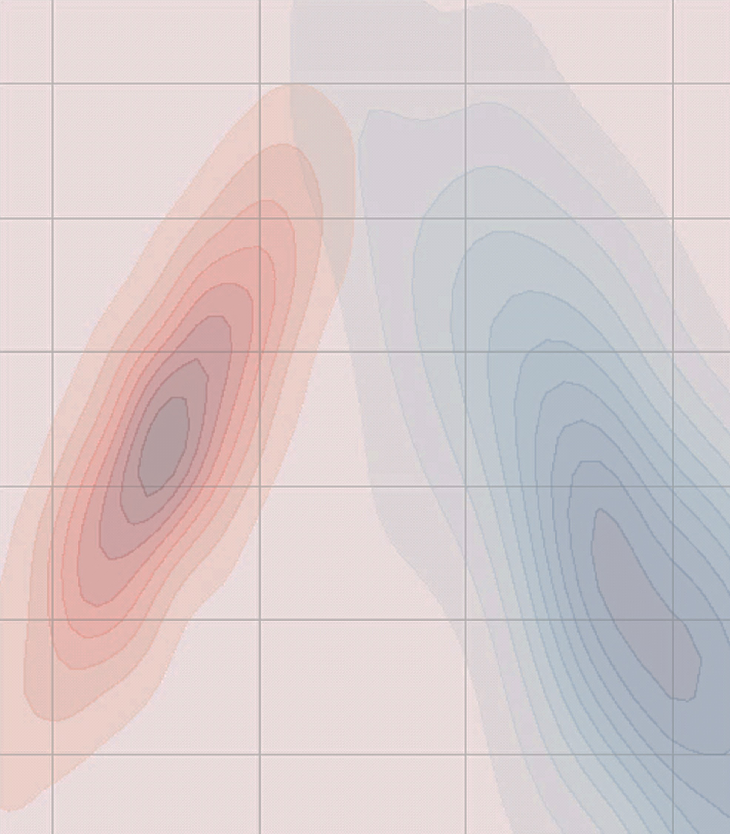
Interrupted
Time Series
Experiments
in Python
Drew Fustin
Automaton Data
drewfustin@gmail.com
@drewfustin
github.com/drewfustin/talks__time-series-experiments
@drewfustin | PyData Ann Arbor | 2017-12-07

Slide 2


Interrupted
Time Series
Experiments
in Python
Typical Experimentation in Data Science
Time Series Experiments / Regression Discontinuity
Simulating Time Series Data
ARIMA Algebra and Forecasting with statsmodels
Modeling Interruptions with PyMC3
@drewfustin | PyData Ann Arbor | 2017-12-07

Slide 3




Me
Automaton Data
available for hire!
drew@automatondata.com
PhD, Physics
Data Scientist
@drewfustin | PyData Ann Arbor | 2017-12-07

Slide 4

You?
Hypothesis Testing (e.g. A/B Testing)?
Time Series Forecasting (e.g. ARIMA)?
Probability Distributions (e.g. Poisson)?
Markov Chain Monte Carlo (MCMC)?
@drewfustin | PyData Ann Arbor | 2017-12-07

Slide 5
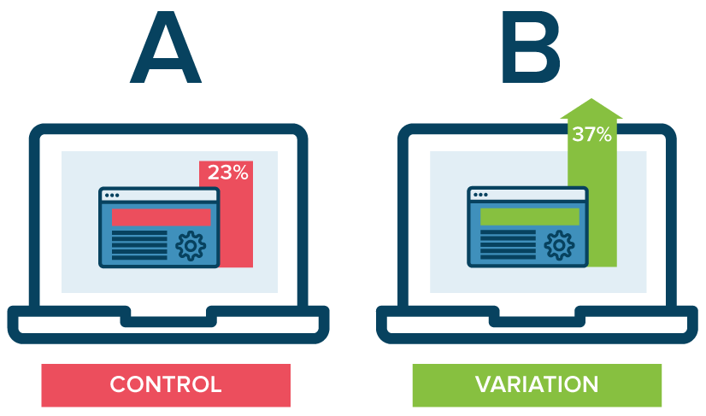
Typical Experiments
source: Optimizely
Select Control/Variant populations (a, b)
Vary something and measure the change
Run concurrently to avoid unnecessary variation
@drewfustin | PyData Ann Arbor | 2017-12-07

Slide 6
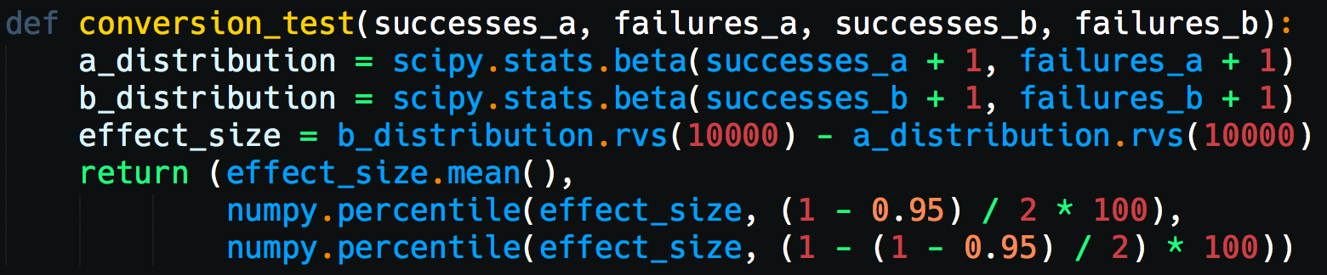
Typical Experiments
e.g. A/B testing conversion rate
@drewfustin | PyData Ann Arbor | 2017-12-07

Slide 7
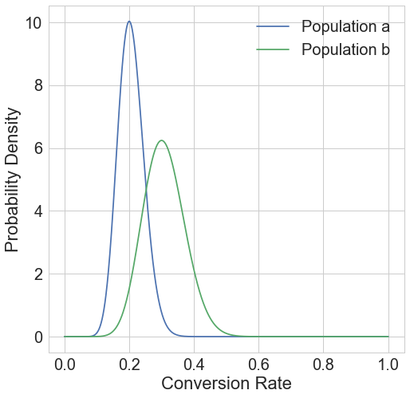
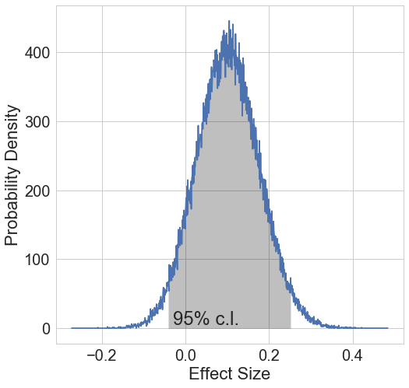
Typical Experiments
a = 100 observations, 20 successes
b = 50 observations, 15 successes
Effect Size = [-4%, 25%] to 95% confidence
@drewfustin | PyData Ann Arbor | 2017-12-07

Slide 8

Experimentation is easy!
@drewfustin | PyData Ann Arbor | 2017-12-07

Slide 9

Experimentation can be hard
@drewfustin | PyData Ann Arbor | 2017-12-07

Slide 10
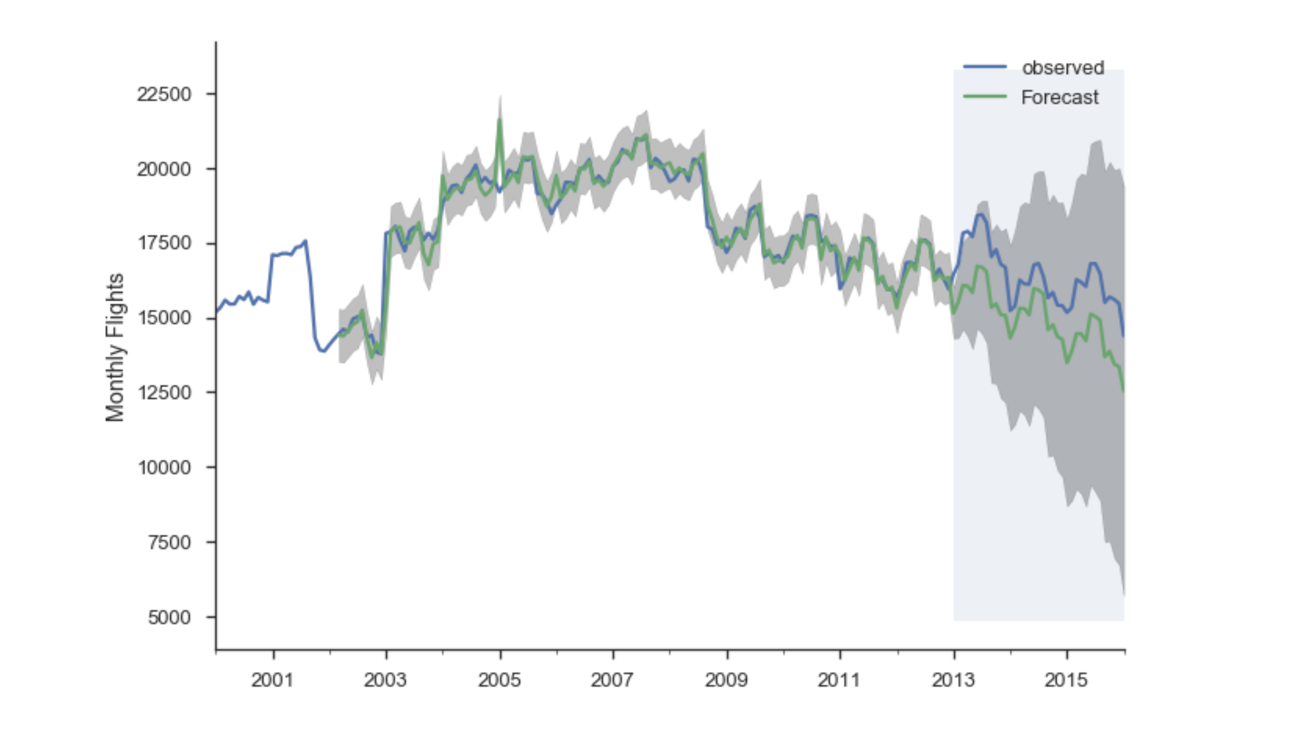
Experimentation can be hard
source: Tom Augspurger, tomaugspurger.github.io/modern-7-timeseries
What if you can’t experiment on concurrent populations?
@drewfustin | PyData Ann Arbor | 2017-12-07

Slide 11

Experimentation can be hard
@drewfustin | PyData Ann Arbor | 2017-12-07

Slide 12
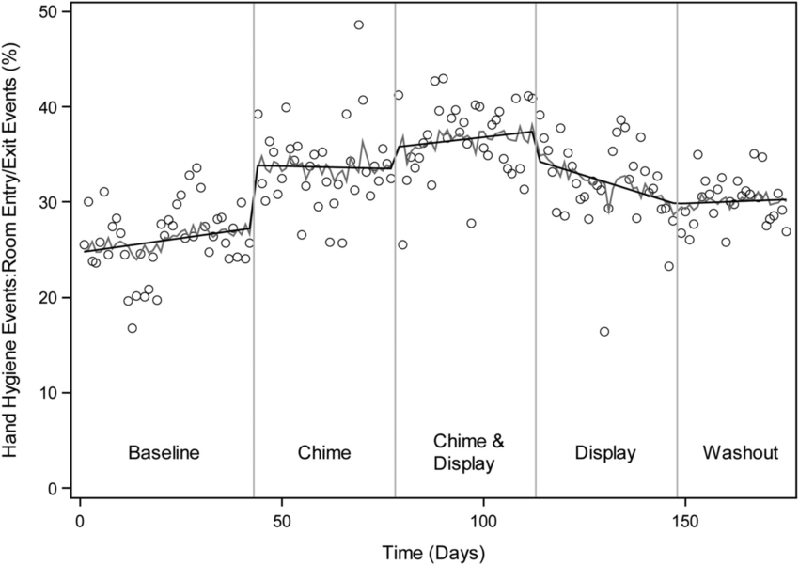
Time Series Experiments
source: Ellison, et al. “A Prospective Controlled Trial of an Electronic Hand Hygiene Reminder System”
Simply apply variation at a moment in time
Measure before vs. after
@drewfustin | PyData Ann Arbor | 2017-12-07

Slide 13

Time Series Experiments
@drewfustin | PyData Ann Arbor | 2017-12-07

Slide 14
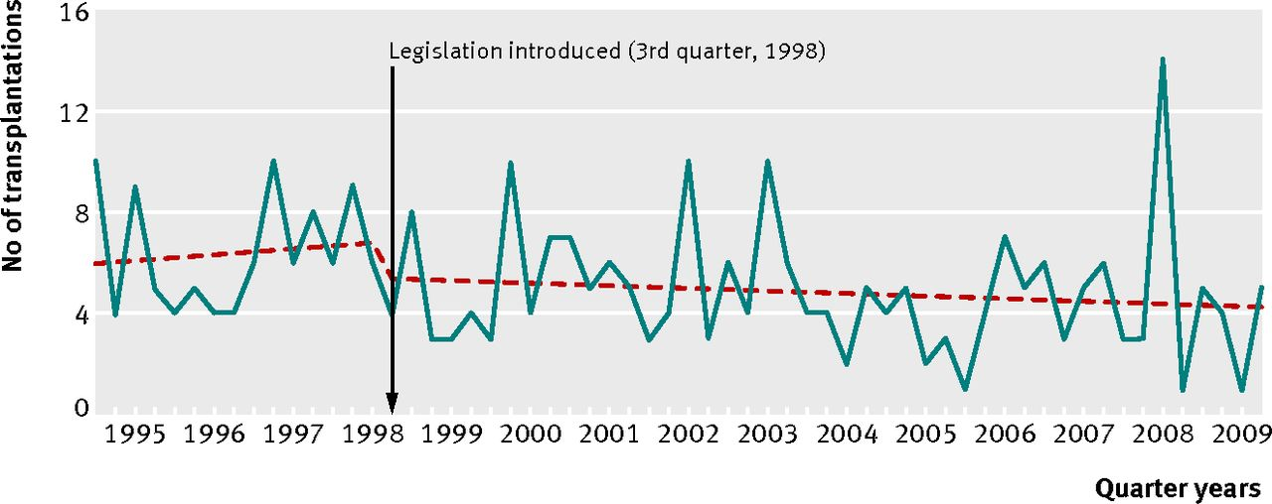
Time Series Experiments
source: Hawton, et al. “Long term effect of reduced pack sizes of paracetamol on poisoning deaths and liver transplant activity in England and Wales: interrupted time series analyses”
Simply apply variation at a moment in time
Measure before vs. after
@drewfustin | PyData Ann Arbor | 2017-12-07

Slide 15
Time Series Experiments
source: Hawton, et al. “Long term effect of reduced pack sizes of paracetamol on poisoning deaths and liver transplant activity in England and Wales: interrupted time series analyses”
“Simply” apply variation at a moment in time
“Measure” before vs. after
@drewfustin | PyData Ann Arbor | 2017-12-07

Slide 16

Time Series Experiments
@drewfustin | PyData Ann Arbor | 2017-12-07

Slide 17
Let’s Give It a Try
@drewfustin | PyData Ann Arbor | 2017-12-07

Slide 18
Make Some Data
Homogeneous Poisson Point Process
@drewfustin | PyData Ann Arbor | 2017-12-07

Slide 19
Make Some Data
Homogeneous Poisson Point Process
points distributed randomly in time
@drewfustin | PyData Ann Arbor | 2017-12-07

Slide 20


Make Some Data
Homogeneous Poisson Point Process
points distributed randomly in time
@drewfustin | PyData Ann Arbor | 2017-12-07

Slide 21

Make Some Data
Homogeneous Poisson Point Process
points distributed randomly in time
@drewfustin | PyData Ann Arbor | 2017-12-07

Slide 22

Make Some Data
Homogeneous Poisson Point Process
points distributed randomly in time
note: the time between events that are Poisson distributed follows an Exponential Distribution with rate
@drewfustin | PyData Ann Arbor | 2017-12-07

Slide 23
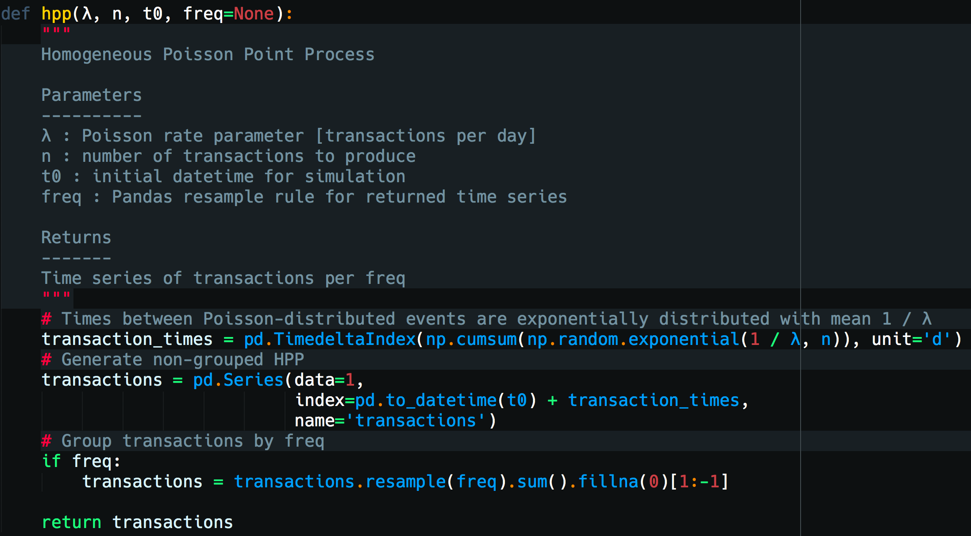
Make Some Data
@drewfustin | PyData Ann Arbor | 2017-12-07

Slide 24
Make Some Data
But, events never occur with a constant rate.
Can we let vary with time?
@drewfustin | PyData Ann Arbor | 2017-12-07

Slide 25
Make Some Data
Nonhomogeneous Poisson Point Process
@drewfustin | PyData Ann Arbor | 2017-12-07

Slide 26

Make Some Data
Nonhomogeneous Poisson Point Process
@drewfustin | PyData Ann Arbor | 2017-12-07

Slide 27






Make Some Data
Nonhomogeneous Poisson Point Process
Generation:
Generate HPP with rate
Attach a random number bounded by [0, 1] to each point in the HPP process
Generate a rate function bounded by [0, 1] such that for any such that
Discard any point in the HPP for which
@drewfustin | PyData Ann Arbor | 2017-12-07

Slide 28
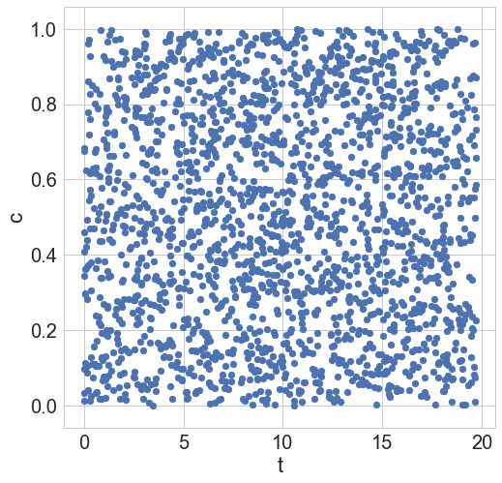
Make Some Data
Nonhomogeneous Poisson Point Process
@drewfustin | PyData Ann Arbor | 2017-12-07

Slide 29
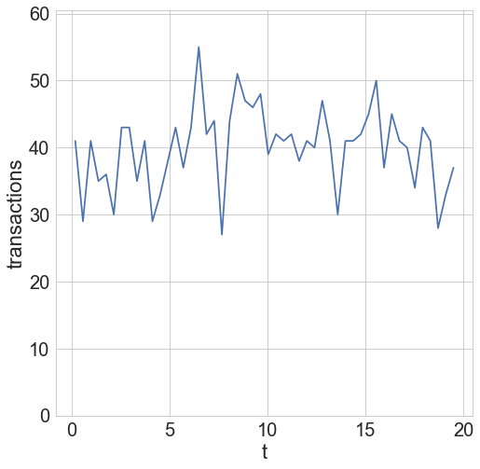
Make Some Data
Nonhomogeneous Poisson Point Process
@drewfustin | PyData Ann Arbor | 2017-12-07

Slide 30
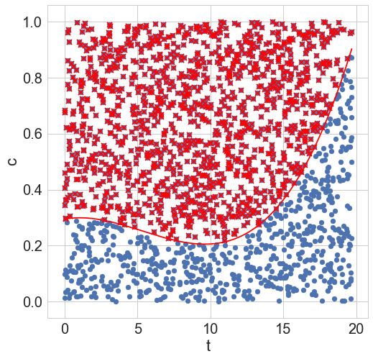
Make Some Data
Nonhomogeneous Poisson Point Process
@drewfustin | PyData Ann Arbor | 2017-12-07

Slide 31
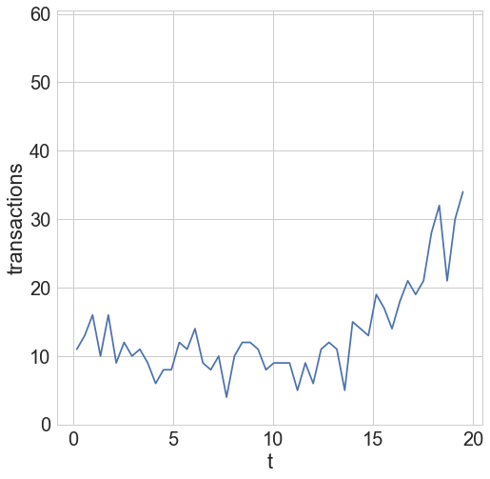
Make Some Data
Nonhomogeneous Poisson Point Process
@drewfustin | PyData Ann Arbor | 2017-12-07

Slide 32
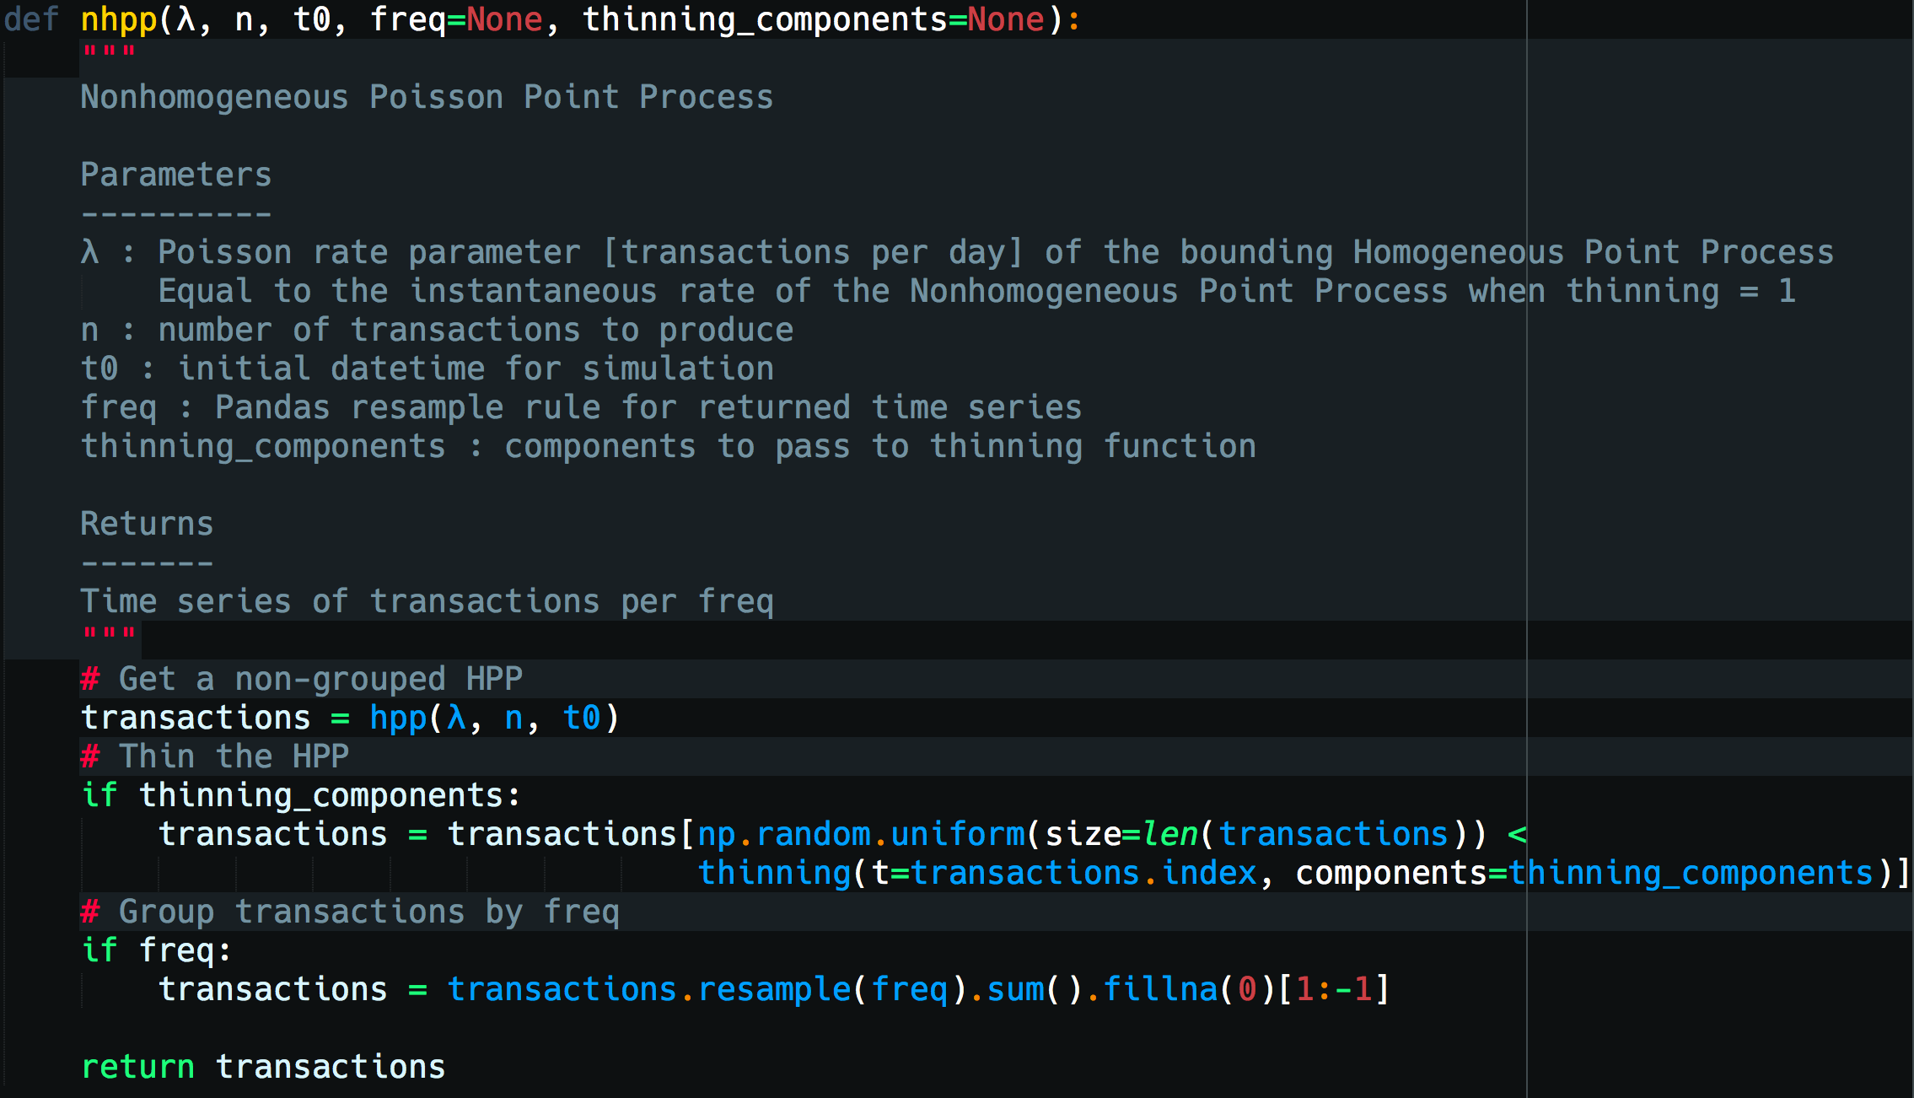
Make Some Data
@drewfustin | PyData Ann Arbor | 2017-12-07

Slide 33
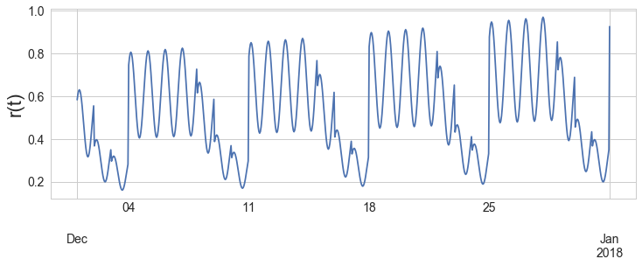
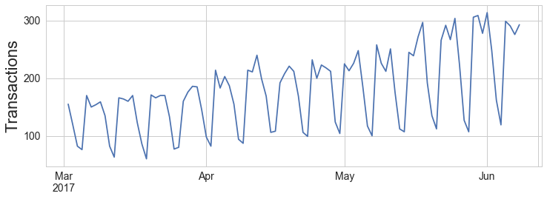
Make Some Data
@drewfustin | PyData Ann Arbor | 2017-12-07

Slide 34

Make Some Data
@drewfustin | PyData Ann Arbor | 2017-12-07

Slide 35
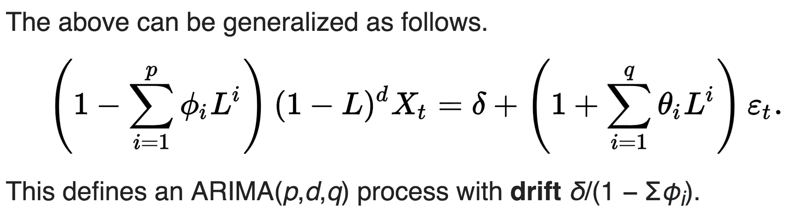
ARIMA Algebra
Autoregressive (AR) Integrated (I) Moving Average (MA)
@drewfustin | PyData Ann Arbor | 2017-12-07

Slide 36

ARIMA Algebra
@drewfustin | PyData Ann Arbor | 2017-12-07

Slide 37

ARIMA Algebra
@drewfustin | PyData Ann Arbor | 2017-12-07

Slide 38

ARIMA Algebra
Autoregressive (AR) [order p]
@drewfustin | PyData Ann Arbor | 2017-12-07

Slide 39
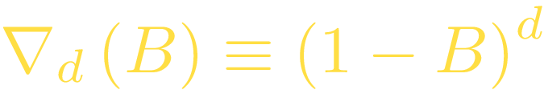

ARIMA Algebra
Autoregressive (AR) [order p]
Integrated (I) [order d]
@drewfustin | PyData Ann Arbor | 2017-12-07

Slide 40

ARIMA Algebra
Autoregressive (AR) [order p]
Integrated (I) [order d]
Moving Average (MA) [order q]
@drewfustin | PyData Ann Arbor | 2017-12-07

Slide 41
ARIMA Algebra
This generalizes to a Seasonal ARIMA:
@drewfustin | PyData Ann Arbor | 2017-12-07

Slide 42
ARIMA Algebra
This generalizes to a Seasonal ARIMA:
e.g. Seasonal Moving Average (MA) [order Q]
@drewfustin | PyData Ann Arbor | 2017-12-07

Slide 43
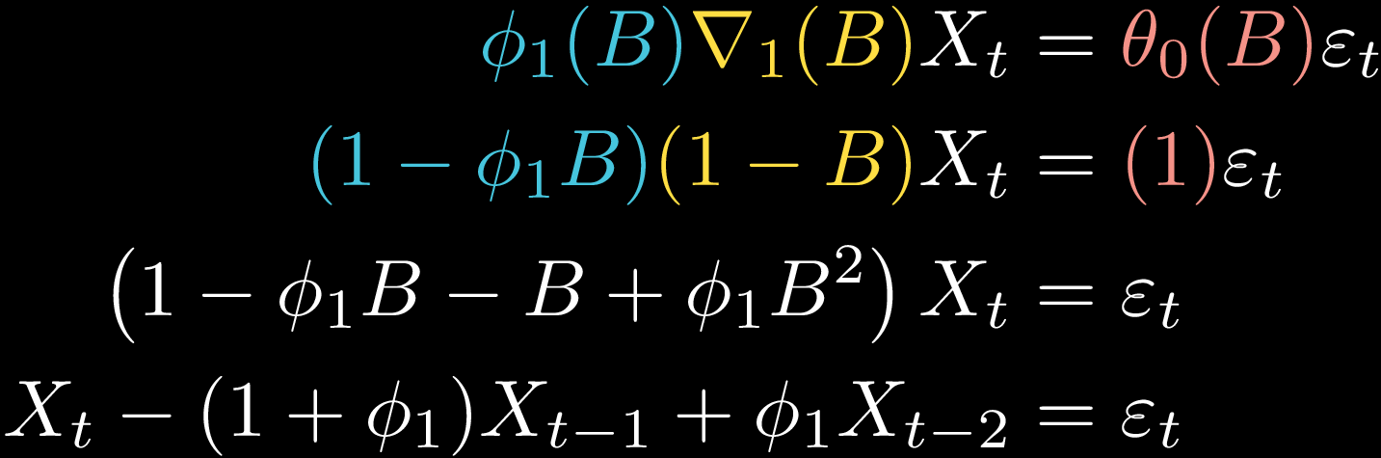
ARIMA Algebra
e.g. ARIMA (1, 1, 0):
@drewfustin | PyData Ann Arbor | 2017-12-07

Slide 44

ARIMA Algebra
@drewfustin | PyData Ann Arbor | 2017-12-07

Slide 45

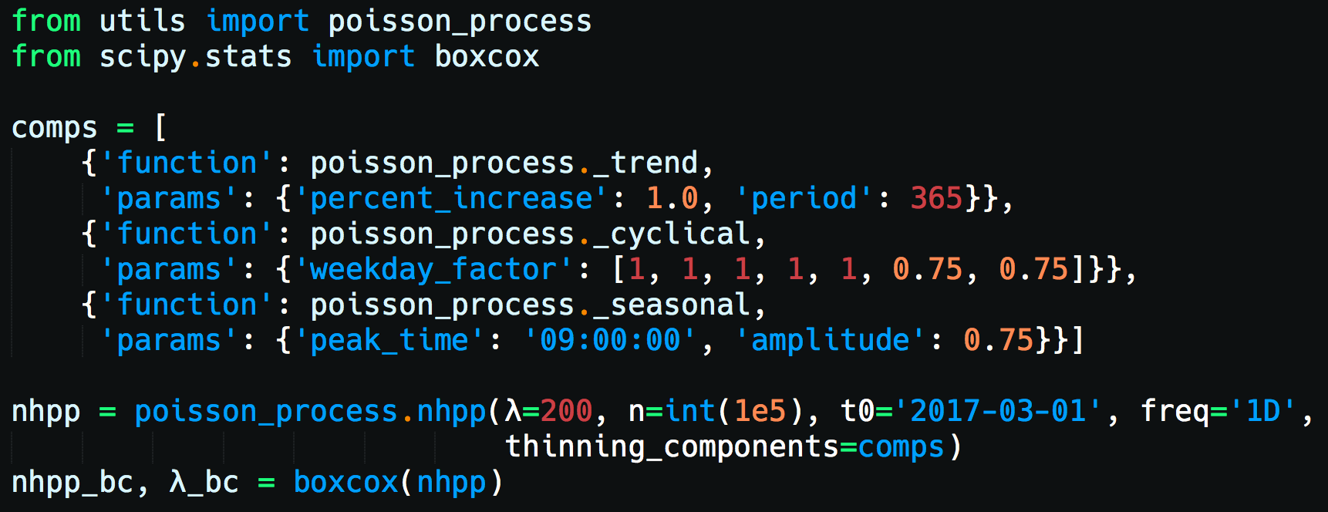
Forecasting with ARIMA
Box-Cox Transformation
power transformation to impose normality on the time series
@drewfustin | PyData Ann Arbor | 2017-12-07

Slide 46
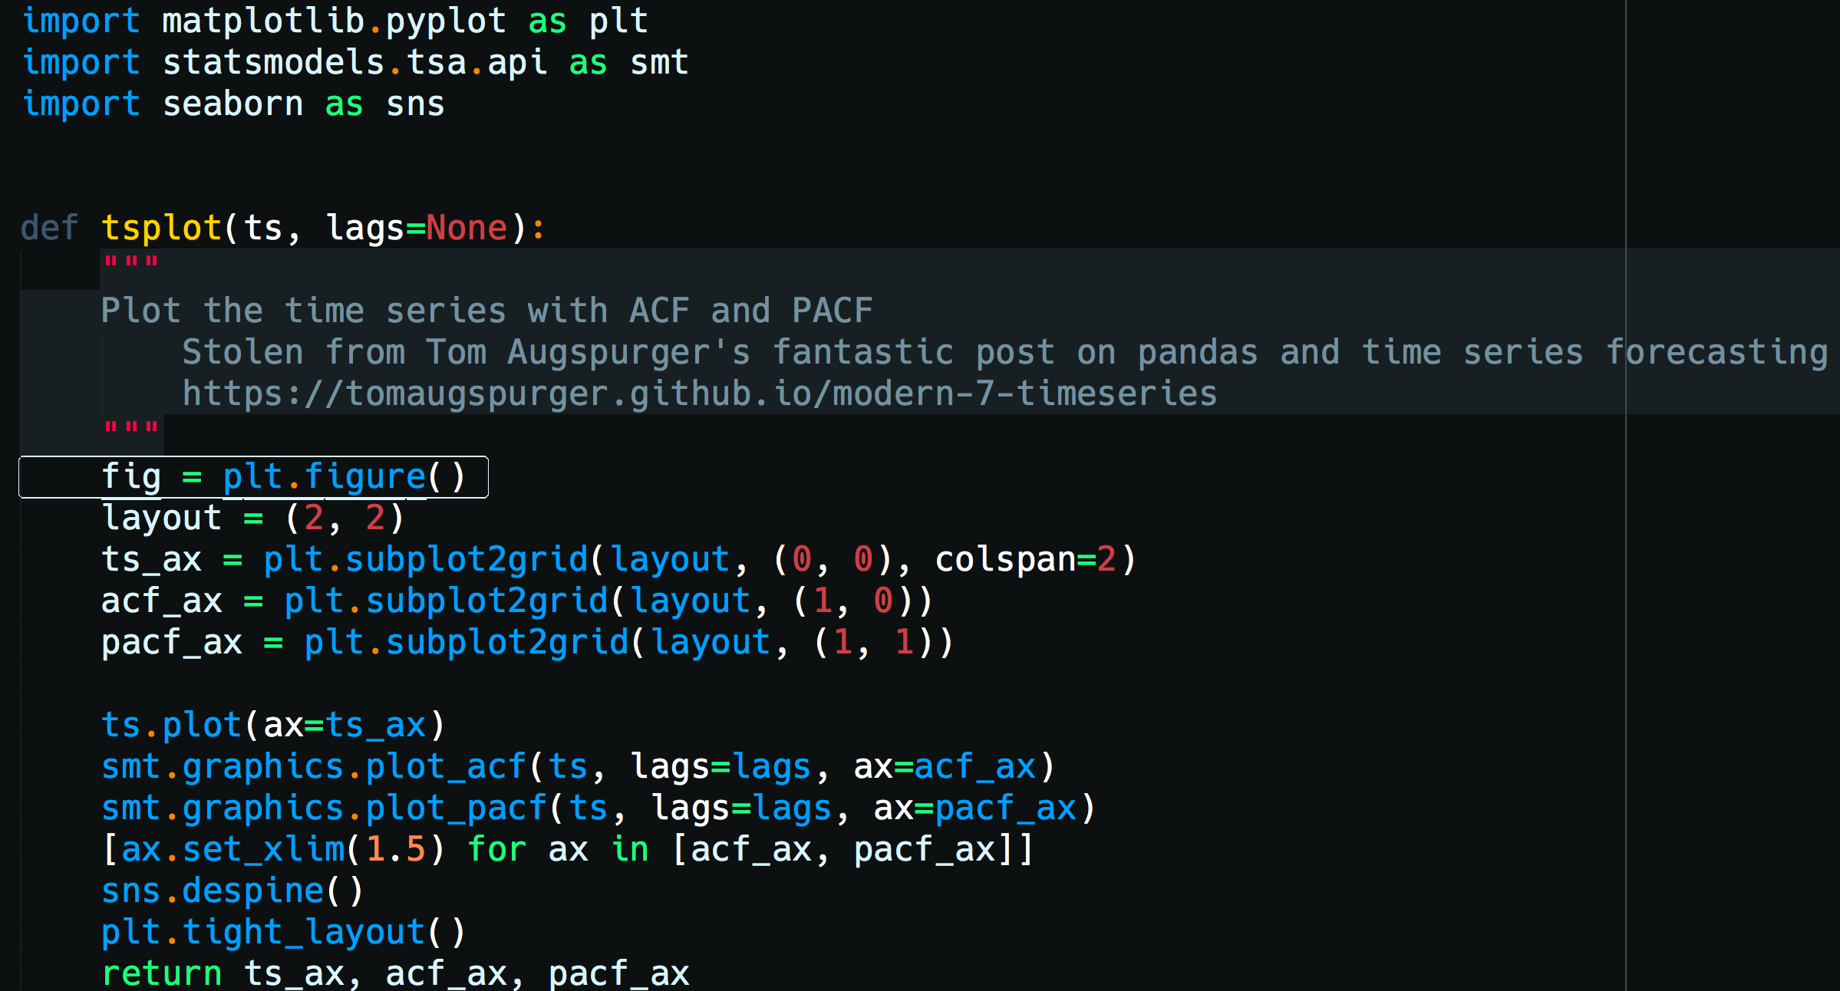
Forecasting with ARIMA
(Partial) Autocorrelation Functions ACF/PACF plots
@drewfustin | PyData Ann Arbor | 2017-12-07

Slide 47
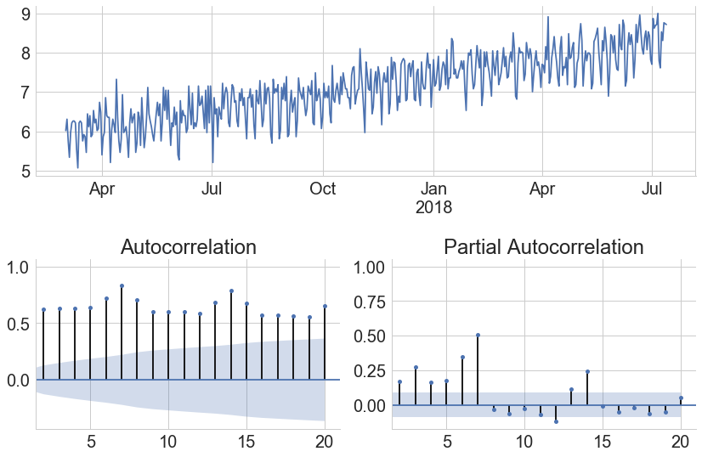
Forecasting with ARIMA
(Partial) Autocorrelation Functions ACF/PACF plots
@drewfustin | PyData Ann Arbor | 2017-12-07

Slide 48
Forecasting with ARIMA
(Partial) Autocorrelation Functions ACF/PACF plots
Get rid of these
@drewfustin | PyData Ann Arbor | 2017-12-07

Slide 49
Forecasting with ARIMA
(Partial) Autocorrelation Functions ACF/PACF plots
ACF being so high for so long suggests Integrated [d>0]
@drewfustin | PyData Ann Arbor | 2017-12-07

Slide 50
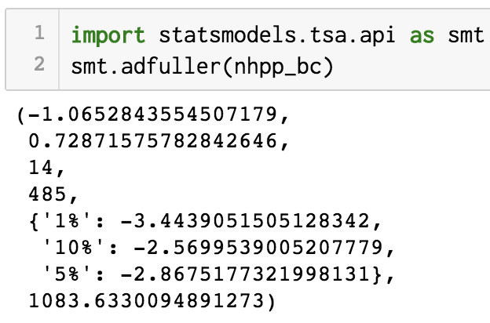
Forecasting with ARIMA
(Partial) Autocorrelation Functions ACF/PACF plots
ACF being so high for so long suggests Integrated [d>0]
as does a test for Stationarity,
Adjusted Dickey-Fuller Test
(this is the p-value for the time series being stationary)
@drewfustin | PyData Ann Arbor | 2017-12-07

Slide 51
Forecasting with ARIMA
(Partial) Autocorrelation Functions ACF/PACF plots
ACF being so high for so long suggests Integrated [d>0]
as does a test for Stationarity,
Adjusted Dickey-Fuller Test
suggests Seasonal [s=7]
@drewfustin | PyData Ann Arbor | 2017-12-07

Slide 52
Forecasting with ARIMA
(Partial) Autocorrelation Functions ACF/PACF plots
ACF being so high for so long suggests Integrated [d>0]
as does a test for Stationarity,
Adjusted Dickey-Fuller Test
suggests Seasonal [s=7]
Try:
@drewfustin | PyData Ann Arbor | 2017-12-07

Slide 53
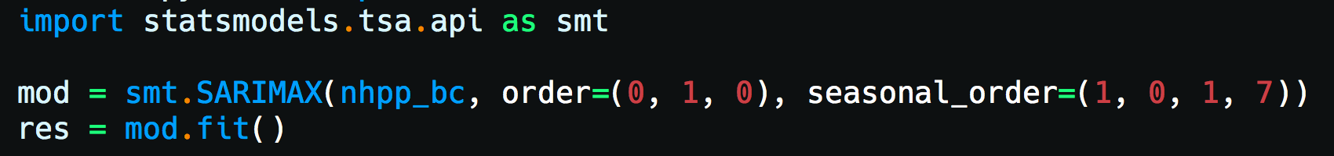
Forecasting with ARIMA
@drewfustin | PyData Ann Arbor | 2017-12-07

Slide 54
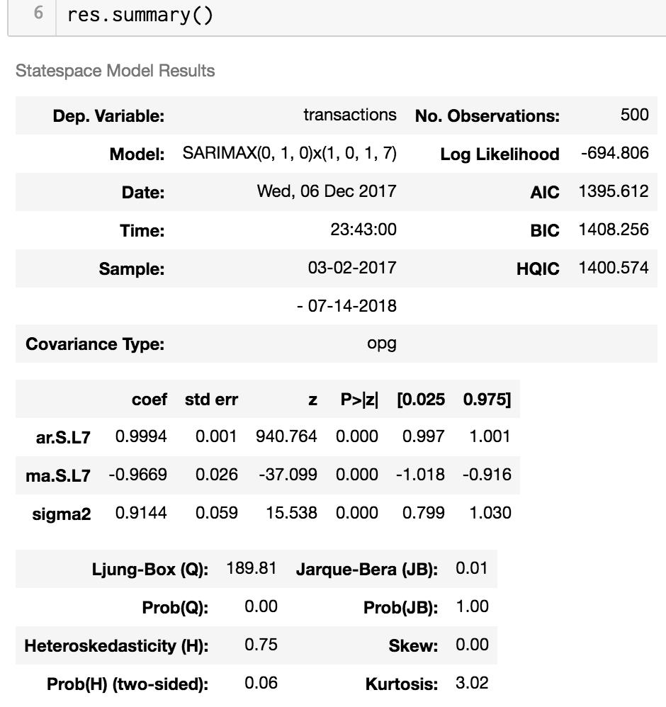
Forecasting with ARIMA
@drewfustin | PyData Ann Arbor | 2017-12-07

Slide 55
Forecasting with ARIMA
AIC
measures goodness-of-fit
but punishes for using more parameters.
Smaller AIC implies a better model.
@drewfustin | PyData Ann Arbor | 2017-12-07

Slide 56

Forecasting with ARIMA
AIC
measures goodness-of-fit
but punishes for using more parameters.
Smaller AIC implies a better model.
@drewfustin | PyData Ann Arbor | 2017-12-07

Slide 57
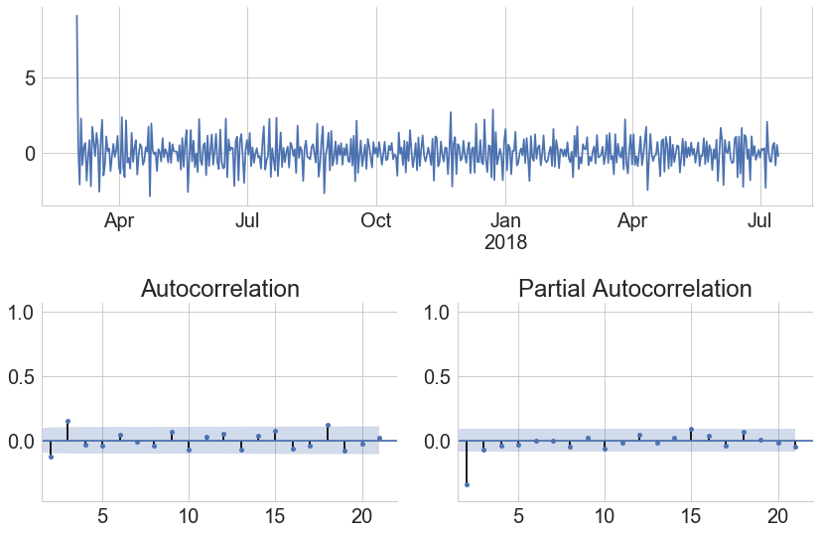
Forecasting with ARIMA
@drewfustin | PyData Ann Arbor | 2017-12-07

Slide 58
Forecasting with ARIMA
PACF being non-zero at 1
but falling quickly after
suggests Moving Average [q=1]
MA(1) is memory-less,
covariance for steps > 1 should be 0
@drewfustin | PyData Ann Arbor | 2017-12-07

Slide 59

Forecasting with ARIMA
ACF being non-zero above 1
suggests Autoregression [p>0]
PACF being non-zero at 1
but falling quickly after
suggests Moving Average [q=1]
covariance for steps > 0 decays as
MA(1) is memory-less,
covariance for steps > 1 should be 0
@drewfustin | PyData Ann Arbor | 2017-12-07

Slide 60
Forecasting with ARIMA
ACF being non-zero above 1
suggests Autoregression [p>0]
PACF being non-zero at 1
but falling quickly after
suggests Moving Average [q=1]
Try:
@drewfustin | PyData Ann Arbor | 2017-12-07

Slide 61
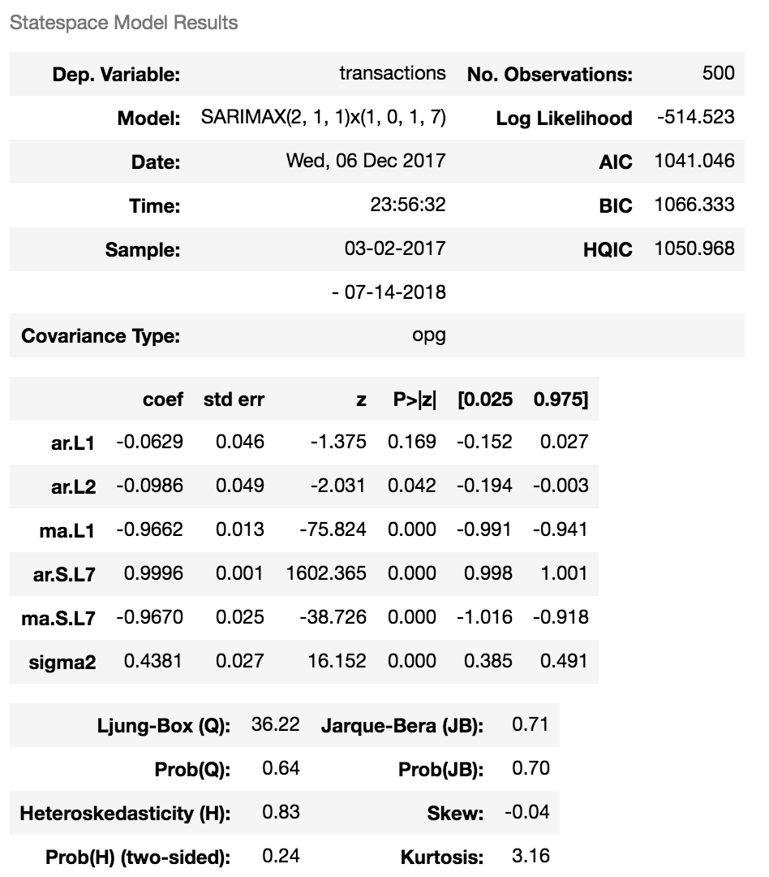
Forecasting with ARIMA
@drewfustin | PyData Ann Arbor | 2017-12-07

Slide 62
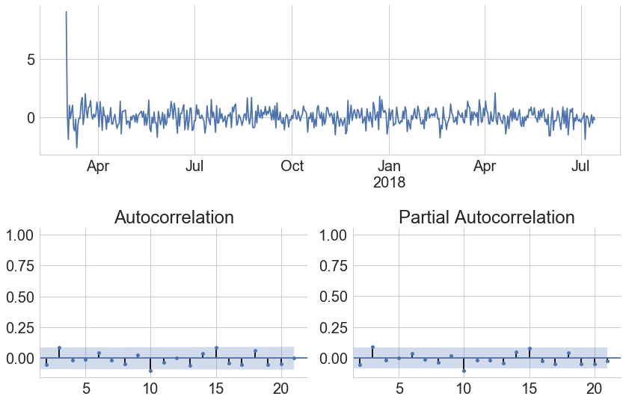
Forecasting with ARIMA
@drewfustin | PyData Ann Arbor | 2017-12-07

Slide 63

Forecasting with ARIMA
@drewfustin | PyData Ann Arbor | 2017-12-07

Slide 64
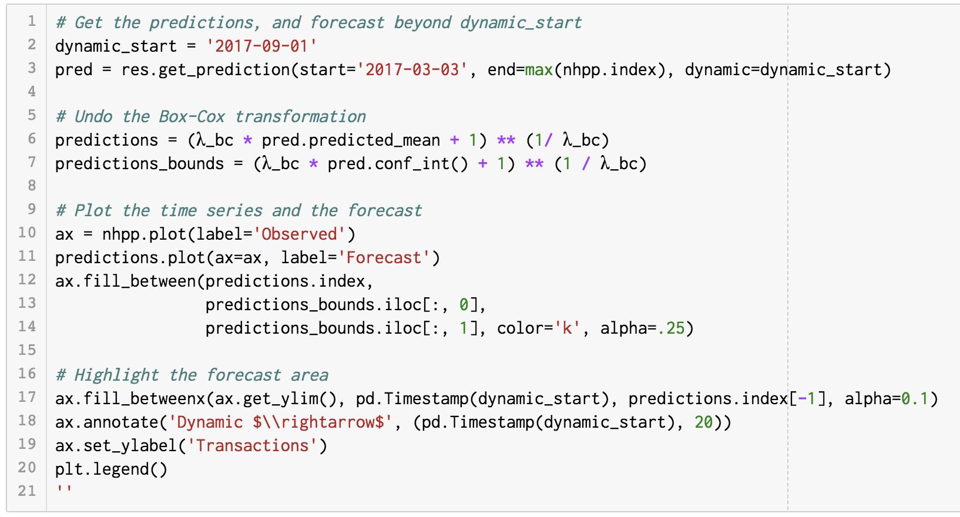
Forecasting with ARIMA
@drewfustin | PyData Ann Arbor | 2017-12-07

Slide 65
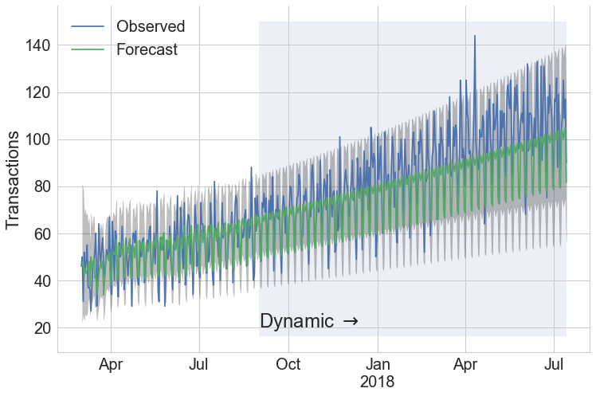
Forecasting with ARIMA
@drewfustin | PyData Ann Arbor | 2017-12-07

Slide 66


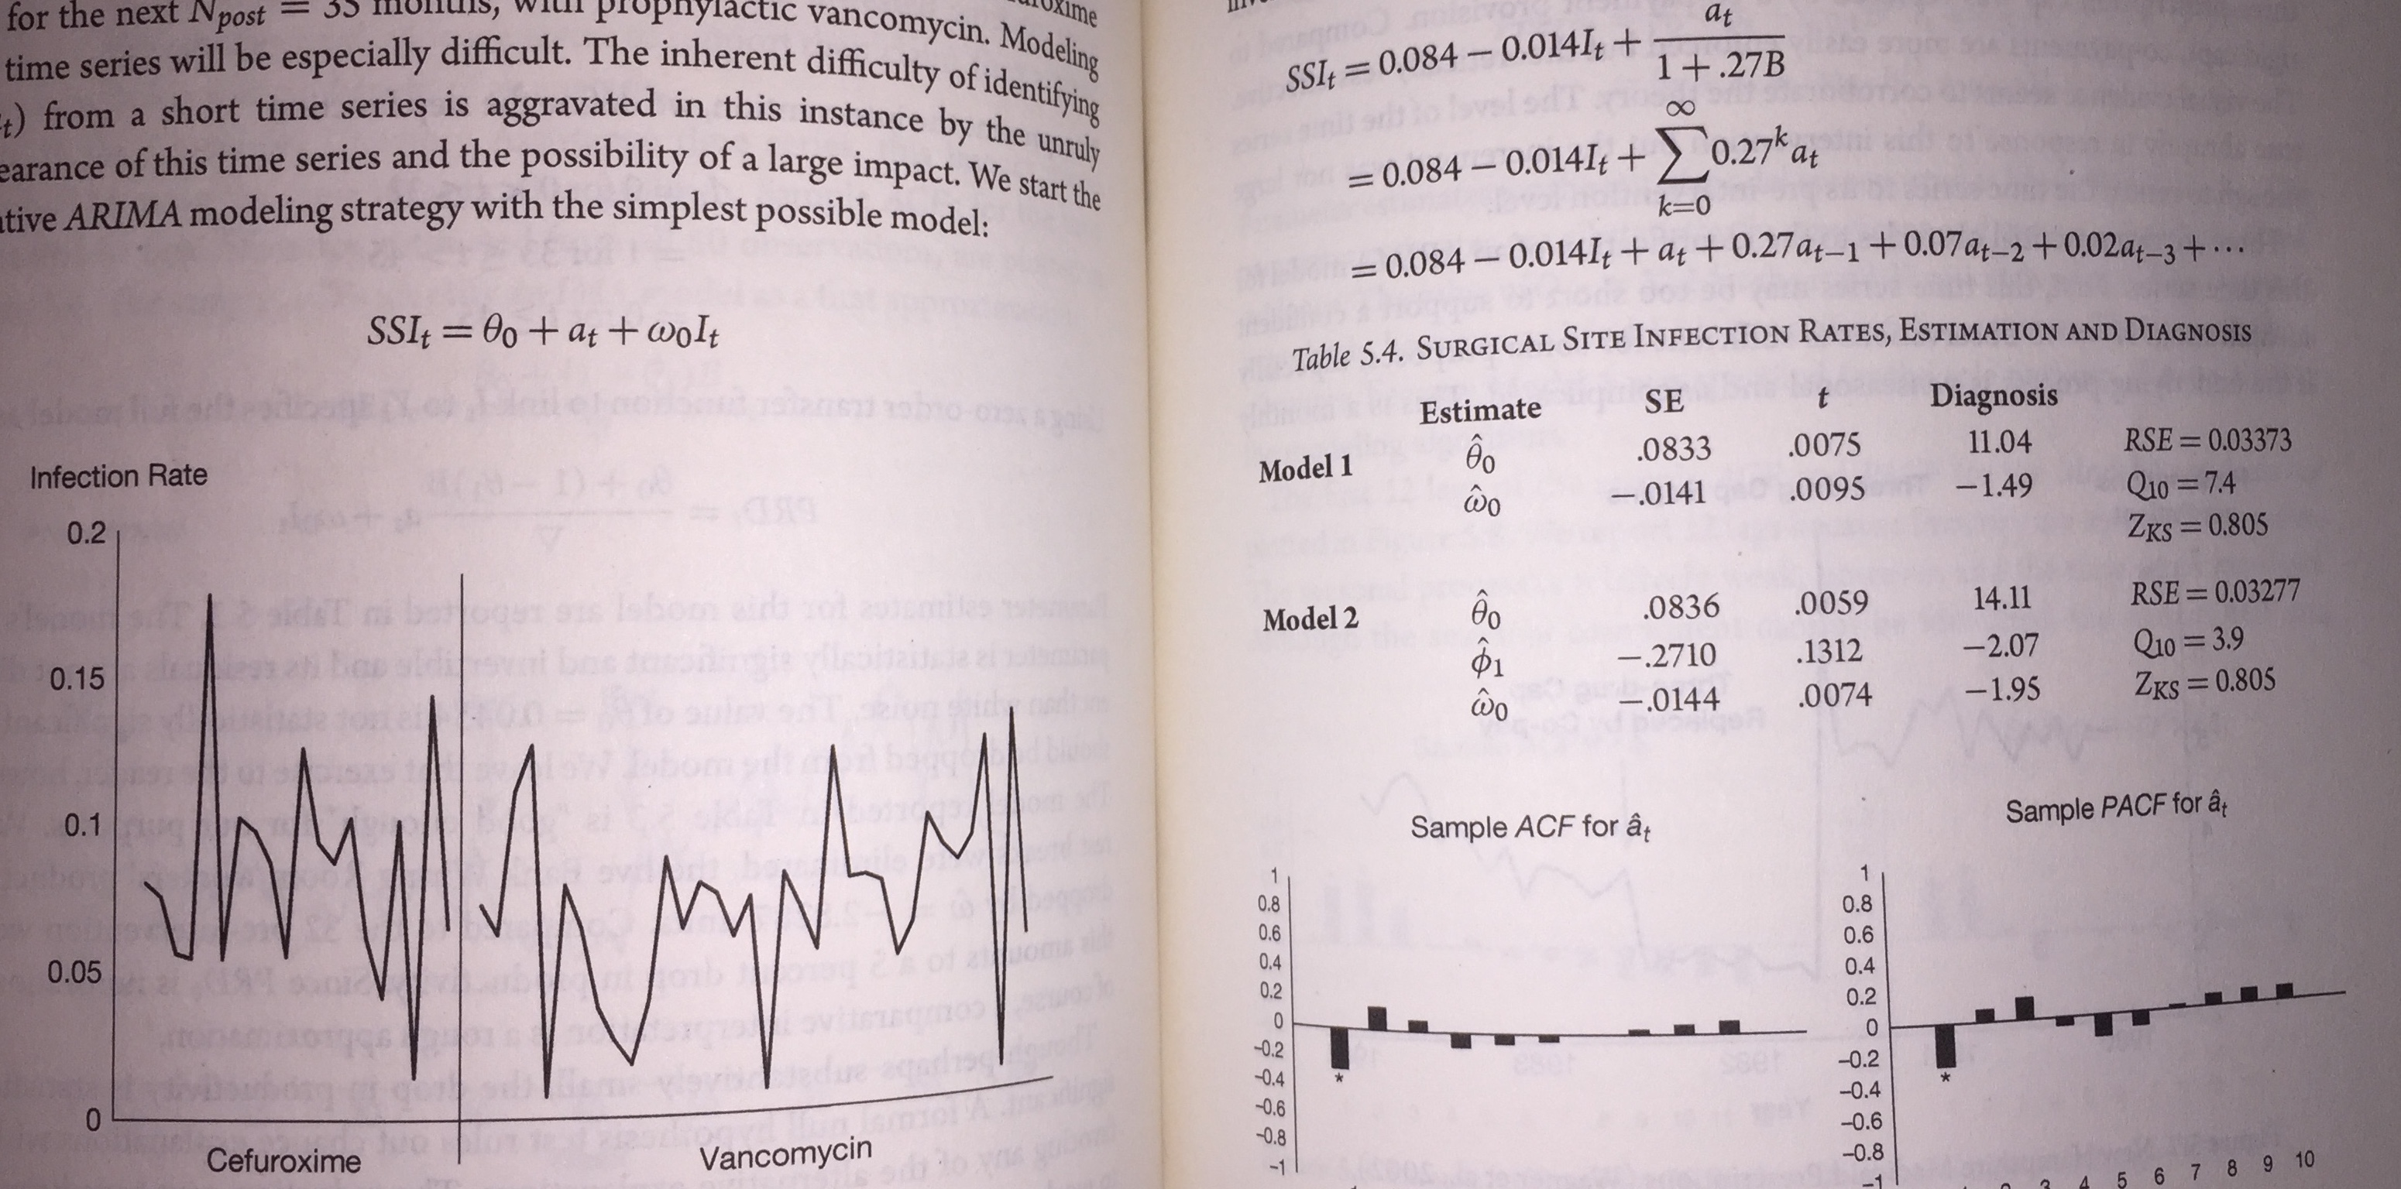
Interrupted Time Series
Introduce variant at time of effect size
Basic idea : Fit ARIMA + effect size
source: McCleary, et al. “Design and Analysis of Time Series Experiments”
@drewfustin | PyData Ann Arbor | 2017-12-07

Slide 67
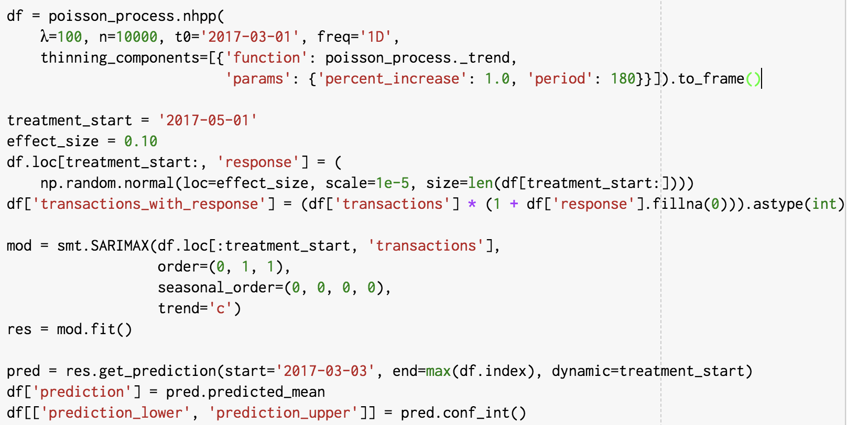
Interrupted Time Series
Start with a simple time series, for illustration
@drewfustin | PyData Ann Arbor | 2017-12-07

Slide 68
Interrupted Time Series
Add a small effect size at some start time
@drewfustin | PyData Ann Arbor | 2017-12-07

Slide 69
Interrupted Time Series
Find the ARIMA model that fits best
@drewfustin | PyData Ann Arbor | 2017-12-07

Slide 70
Interrupted Time Series
Get the predictions and confidence bands
@drewfustin | PyData Ann Arbor | 2017-12-07

Slide 71
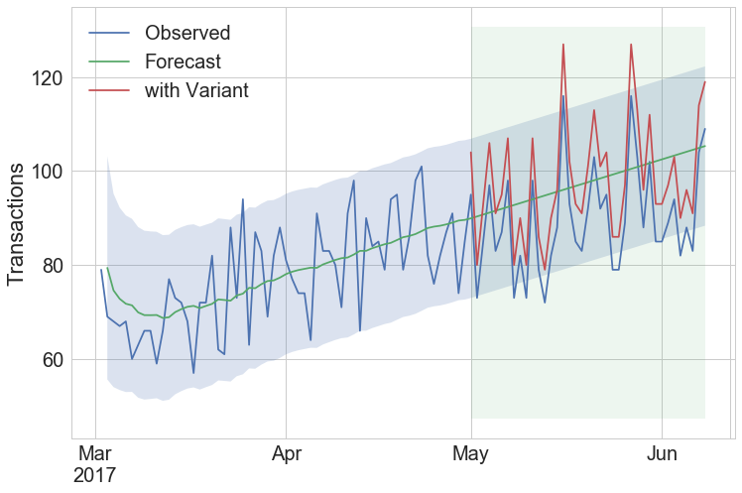
Interrupted Time Series
Our Data Set
@drewfustin | PyData Ann Arbor | 2017-12-07

Slide 72
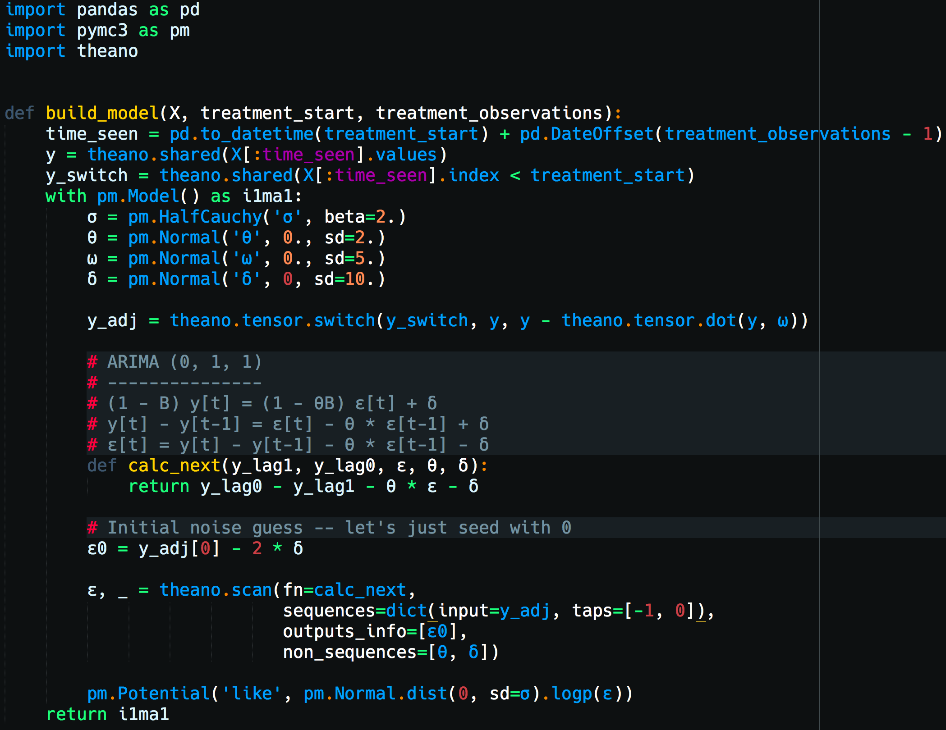
Interrupted Time Series
@drewfustin | PyData Ann Arbor | 2017-12-07

Slide 73
Interrupted Time Series
Case statement:
left = control
right = variant
[effect size = β]
@drewfustin | PyData Ann Arbor | 2017-12-07

Slide 74
Interrupted Time Series
Case statement:
left = control
right = variant
[effect size = β]
ARIMA (0, 1, 1)
@drewfustin | PyData Ann Arbor | 2017-12-07

Slide 75
Interrupted Time Series
Case statement:
left = control
right = variant
[effect size = β]
ARIMA (0, 1, 1)
Looping in Theano
@drewfustin | PyData Ann Arbor | 2017-12-07

Slide 76
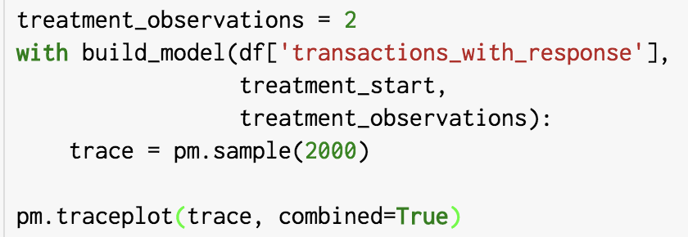

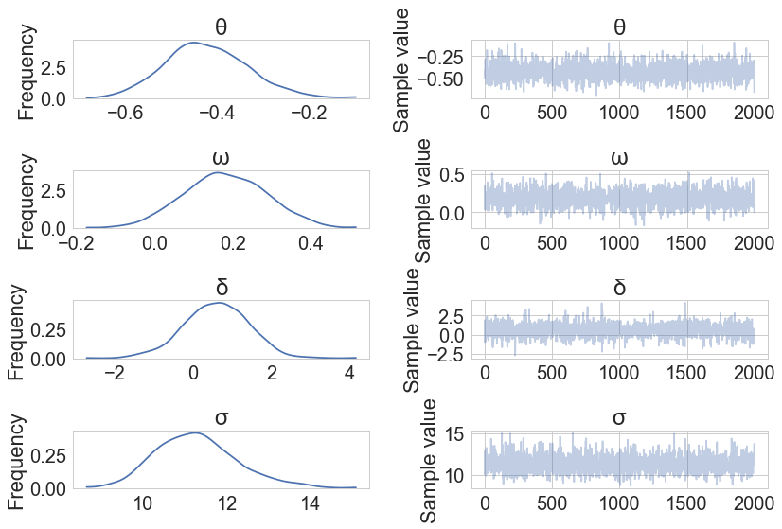
Interrupted Time Series
effect size estimation
after 2 observations
@drewfustin | PyData Ann Arbor | 2017-12-07

Slide 77
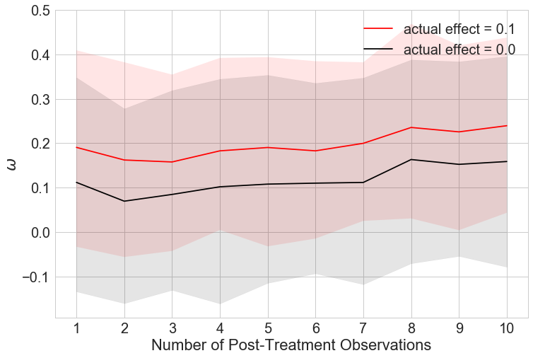
Interrupted Time Series
Estimation of ω when effect size is 10% in reality
compared to when there is no effect size in reality
@drewfustin | PyData Ann Arbor | 2017-12-07

Slide 78
Interrupted Time Series
Estimation of ω when effect size is 10% in reality
compared to when there is no effect size in reality
drift on the “no effect” curve suggests model does not match reality on long time horizons for forecasts
@drewfustin | PyData Ann Arbor | 2017-12-07

Slide 79

Interrupted Time Series
@drewfustin | PyData Ann Arbor | 2017-12-07

Slide 80
Interrupted
Time Series
Experiments
in Python
PhD, Physics
Data Scientist
Drew Fustin
Automaton Data
available for hire!
drew@automatondata.com
github.com/drewfustin/talks__time-series-experiments
@drewfustin | PyData Ann Arbor | 2017-12-07

